Slide 1
Information Deck
Notes:
Bryan

Slide 2
Agenda
General
Q & A Closing the meeting with a few final words
Opening
Remarks
Industry Insights and Tips How Land a Job in IT Industry
Introduction
To Appficiency
Application Process
Brief introduction to who we are, what we do and what we are looking for in a new employee
Brief discussion of the application process
Notes:
Bryan

Slide 3
Overview And Mission
WHO ARE WE?
IT Consultancy focused on providing the best advice in technological solutions unique to business needs
Founded in 2014 to focus on NetSuite ERP Solutions
Currently 150+ Employees with offices in 5 countries
OUR MISSION
Solve the most complex technology challenges
Enables our team members to overcome the most complex business technology challenges
Hire and develop problem solvers to create the most impactful and innovative organization in technology enabled business consulting
Notes:
Mike

Slide 4
Management Team
Johnny Than
Morteza Hosseini
Michael Diep
( Co-owner| Toronto )
( Co-owner | Toronto )
(Chief Operations Officer | Vancouver)
Olivia Lehnertz
Perihan Eid
( Marketing Director I Detroit)
(Director, HCM |Toronto)

Slide 5
Future Plans
Notes:
Mike

Slide 6
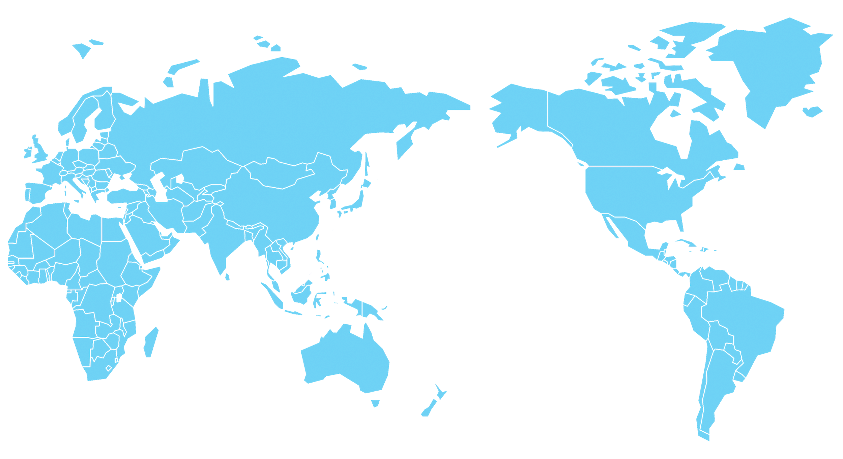
Global Operations Expansion
Europe HQ
(New Business Acquisition 2023)
Vancouver, CA
Sales
Toronto, CA
Global HQ
Middle East
Delivery Support
Japan
(New Office in 2023)
Denver, CO
US Head Office
Pune, IN
Development
Miami
(2022)
LATAM
(2024)
Manila, PHI
Delivery Support
Singapore Asia Pacific Head Office
Current Offices
Planned Expansion
Notes:
Mike

Slide 7
Join An Award Winning Team
Recent Achievements
Notes:
Jace

Slide 8
Appficiency Clients
Sample Client Logos
Public Companies
Notes:
Kwizcom logos: Pfizer, Walt Disney, Cisco ,Airbus, Tiffanys, US customs, wells fargo
Jace

Slide 9
Industry Insights and Tips How Land a Job in IT Industry

Slide 10
Landing a job in IT Industry
Industry Overview
Soft Skills Development & Continuous Learning
Rapid growth in IT
Increasing demand for skilled professionals
Emphasize communication and teamwork.
Essential for client-facing roles.
Emphasize the importance of ongoing education.
Stay updated with industry trends.
Key Skills
ERP Implementation Skills and Education & Certifications
Technical expertise (programming, databases).
Soft skills (communication, problem-solving).
Understanding ERP systems.
Foundation in relevant technologies.
Relevant degrees and courses.
Certifications for added credibility.
Seek internships and entry-level positions.
Hands-on involvement in ERP projects.
Notes:
Peri

Slide 11
Opportunities and Challenges in the IT industry, specifically in ERP implementation
OPPORTUNITIES:
Growing Demand
Rapid adoption of ERP solutions.
Increased demand for ERP professionals.
Diverse Roles
Varied career paths (developer, consultant, analyst).
Opportunities for specialization.
Global Reach
Work on international projects.
Exposure to diverse business environments.
Continuous Learning
Evolving technologies and methodologies.
Room for skill enhancement.
Innovation & Automation
Integration of AI and automation.
Exciting projects in emerging technologies.
Career Advancement
Clear career progression.
Opportunities for leadership roles.
CHALLENGES:
Complex Implementations
Large-scale ERP projects can be intricate.
Handling complex business processes.
Integration Issues
Challenges in integrating with existing systems.
Data migration complexities.
Cost Constraints
Budget limitations in some projects.
Balancing cost-effectiveness.
User Resistance
Employees adapting to new systems.
Change management difficulties.
Security Concerns
Data security and privacy challenges.
Mitigating risks in ERP solutions.
Vendor Selection
Choosing the right ERP vendor.
Navigating vendor-related challenges.

Slide 12
Launching Your IT Career - Tips for Fresh Graduates
Build a Strong & Reputable Online Presence
Research Companies and Networking
Create a professional LinkedIn profile.
Showcase projects and achievements.
Stop resharing malicious article on social media
Understand company culture and values.
Tailor applications to each company.
Attend industry events and meet professionals.
Connect with alumni and professionals on LinkedIn.
Prepare for Interviews:
Research common IT interview questions.
Practice technical and behavioral responses.
Share instances where you solved a complex problem.
Emphasize critical thinking skills.
Convey passion for IT during interviews.
Be curious and open to learning.
Notes:
Peri

Slide 13
Always Stay At The Cutting Edge - Appficiency’s Position in the Industry
Leading Edge Software
Consult with Senior Leaders
High demand expertise: The ERP platform of the
future for business operations
Ability to integrate and learn about many other software platforms
Exposure to corporate finance and day-to-day conversations with executives and controllers
Direct interaction with senior management team on everything from finance and planning to operations and sales
Cross-Functional Consulting
Drive Meaningful Decisions
Take the lead across our industry verticals from Manufacturing, Warehouse to distribution & Retail
Expand into new verticals of interest: software and healthcare
Participate in the enterprise building decision making process for appficiency and your clients
Innovate and implement your best ideas in a fast paced environment
Notes:
Peri
Devin - As a Consultant - Header Pillars of post MBA job-
Leading Edge Software- Gartner Tech recognized, Cloud Based, One of the most sought after ERP
Consult With Senior Leaders- nature of job requires complete visibility to client organizations. You know end to end
Cross Functional- AMP, Software, Construction, Entertainment- know about various business models
Meaningful Decisions- we have access to best practices, industry standard. Clients rely on us. Internal and external

Slide 14
Access To Leadership Opportunities - Appficiency’s Position in the Industry
Build Software Products
Become a Trusted Advisor to Industry Executives
Use your passion for tech to create, customize and improve system processes in our software platform
Be a critical part of our technical team by ensuring client needs are met through software build and updates
Understand different financial structures for various businesses
Develop deep relationships with industry executives to strategically formulate decision-making
Become an Operational Expert
Organize, Lead, and Manage Teams
Manage company workflow and optimize day-to-day activities with ease
Analyze business operations and identify client needs in order to improve work processes
Collaborate daily with senior management to solve day-to-day challenges
Gain opportunity to monitor team performance and build a positive work environment to ensure objectives are met
Notes:
Peri

Slide 15
Career Opportunities and Application Process

Slide 16
Appficiency Opportunities
Exciting Opportunities at Appficiency
Functional Side of Consulting
Strategic Business Consultant
Software Delivery Consultant
Project Manager
Internship Opportunities
The ideal candidates for this consulting role are graduates with a background in BS Accountancy, Business Administration, or other relevant disciplines.
Technical Side of Consulting
Product Support Engineer
Developer
Internship Opportunities
The ideal candidates for this consulting role are graduates with a background in BS IT, Computer Science, Computer Engineering, and other related disciplines.
Ivey Portal
Appficiency Careers page: https://www.appficiency.com/careers/
Notes:
Bryan

Slide 17
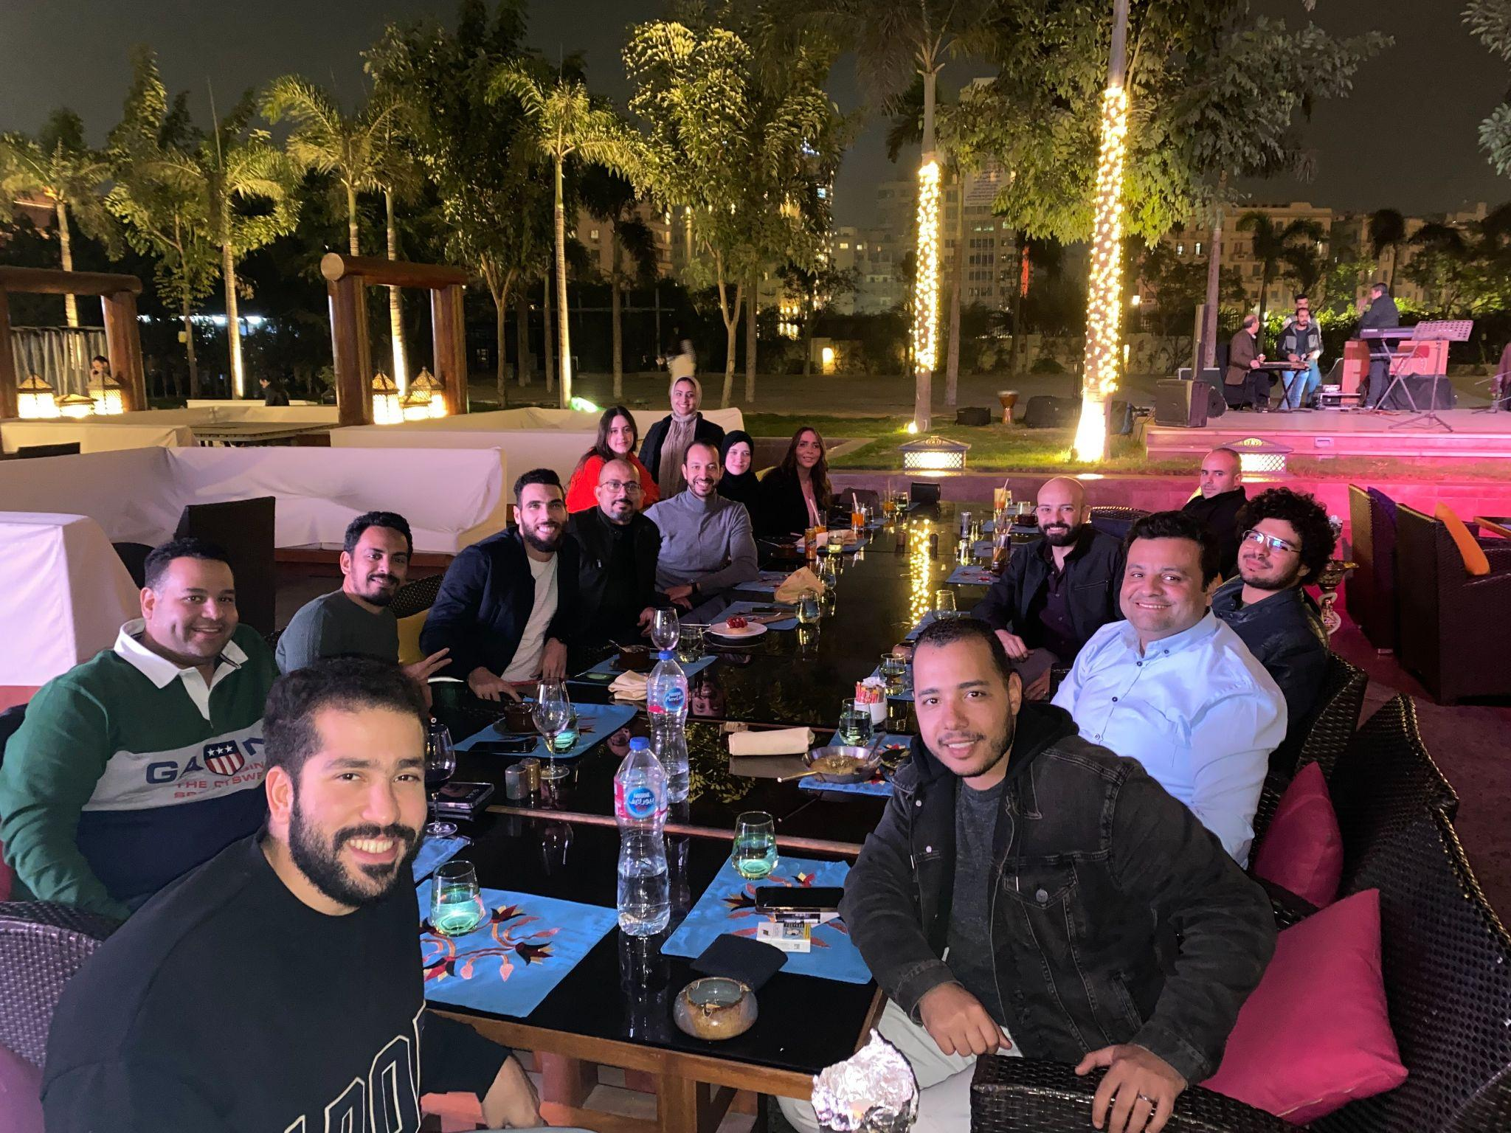
Application Process
Who we are looking for
Driven, smart, tech-savvy individuals with an entrepreneurial spirit
Comfortable working with senior executives
Excellent communication skills and problem-solving abilities
Application Process
Sending of Application thru email
Screening of all applications
Initial and Technical Interview
Case Study Presentation
Job Offer
Notes:
Bryan

Slide 18
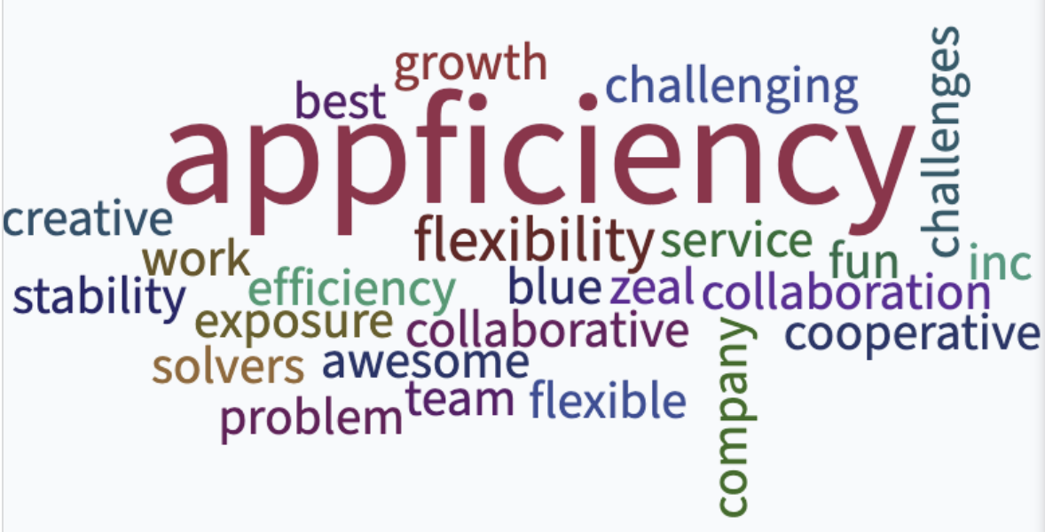
Appficiency Core Values
Problem Solvers
At the intersection of business and technology, we’re here to solve the most complex problems, never backing down from a challenge
Market Makers
We’re creative, ruthless and fearless when it comes to finding new opportunities where others see none.
Business Owners
We take full ownership of the business: how we sell it, how we deliver it and how we maintain it. That’s why we grow!
Notes:
Belle

Slide 19
Follow us
WE ARE MARKET MAKERS
appficiency.com

